Slide 1
Great Depression
1920’s-1930’s Georgia

Slide 2
M.A.I.N: Conflict in Europe
Militarism-
Alliances
Imperialism
Nationalism

Slide 3
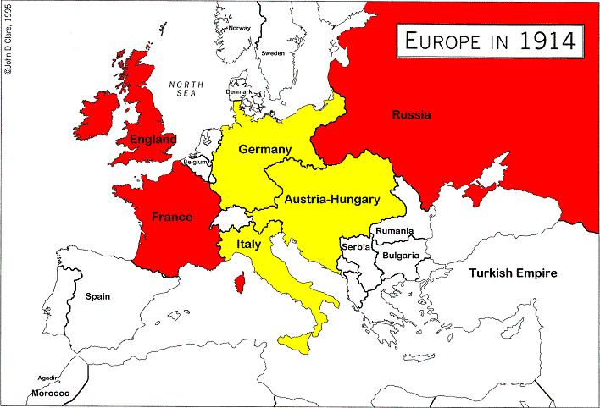
Allied powers red..include U.S./Central powers yellow
SERBIA
Serbian assassinates the
Arch Duke of Austria-Hungary

Slide 4
M.A.I.N: CONFLICT IN EUROPE 1914
Militarism-he belief or desire of a government to build a strong army presence
Alliances-Friendship between countries
Imperialism-Extending a countries power by force or diplomacy.
Nationalism-Showing strong support for a country

Slide 5
BACKGROUND BUILDING: Answers must be detailed and written in complete sentences.
List at least one cause that triggered in Europe( hint>assassination) WW1>PAGE 511
List two reasons why the United States entered WWI ( hint>sinking and telegraph) pages 511-512
List at least FIVE ways that Georgia contributed to WWI>pages 513-514

Slide 6
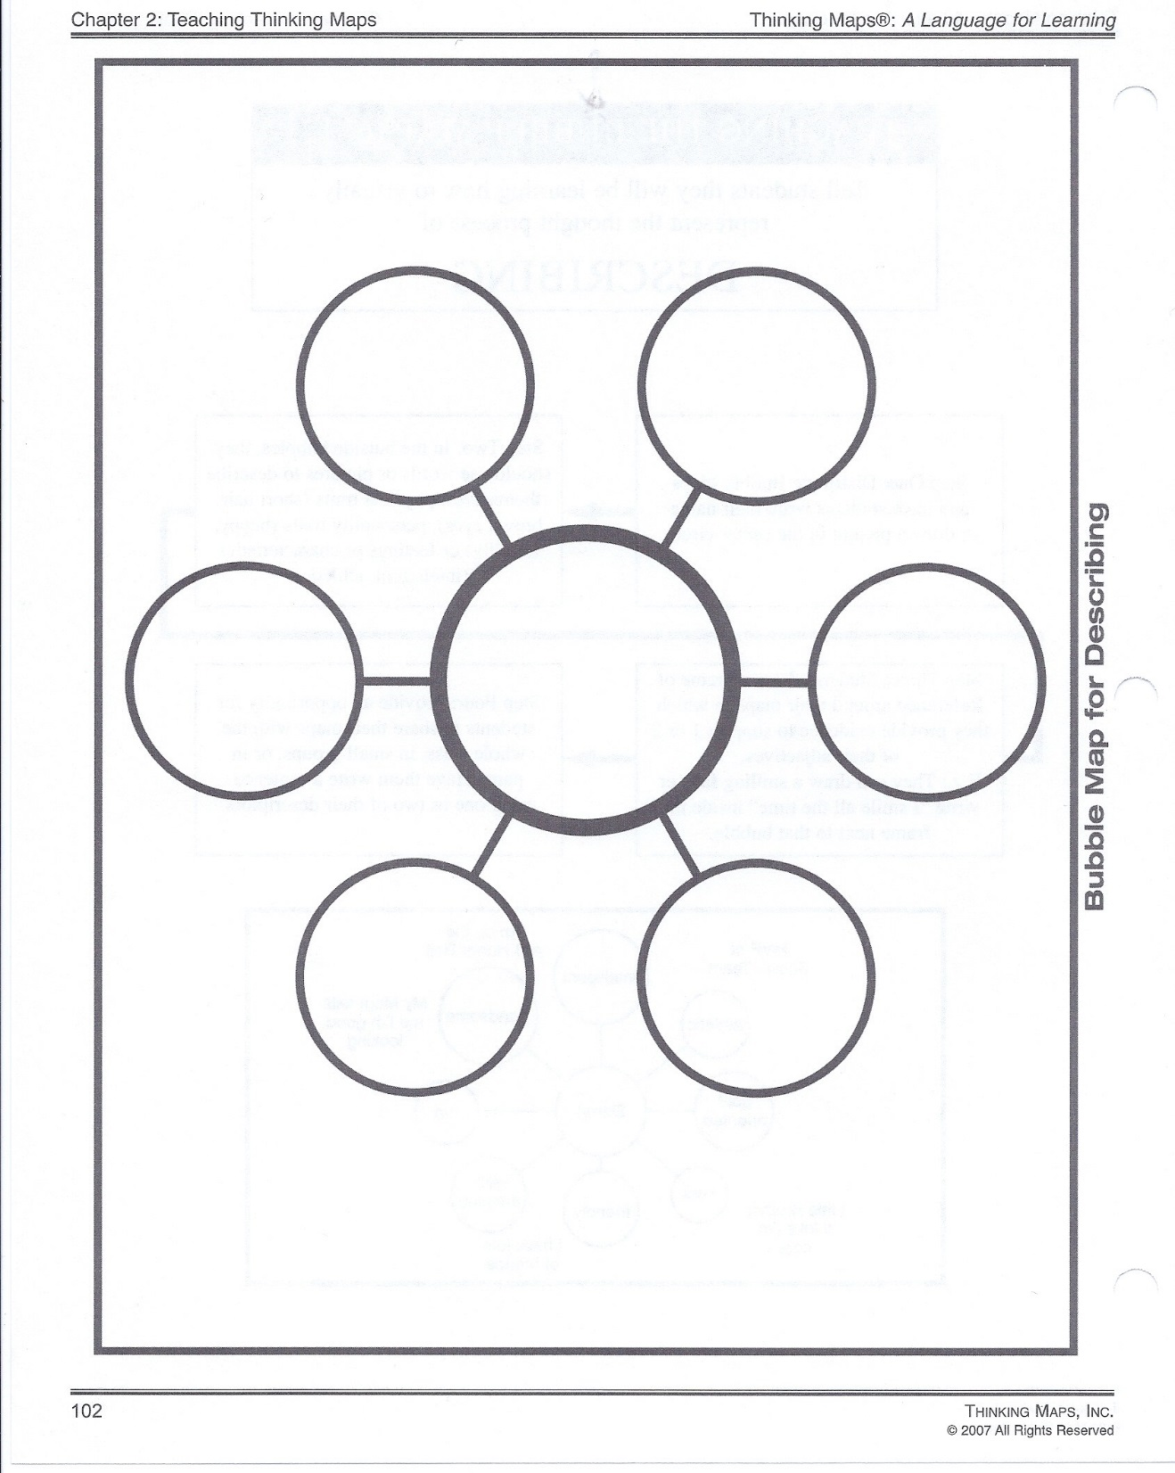
So what:__________________________________________________
________________________________________________________
GEORGIA’S
CONTRIBUTIONS
TO WWI
GA and WWI
So why_________________________________________________
_______________________________________________________

Slide 7
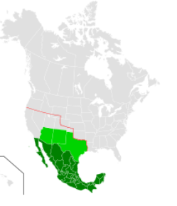
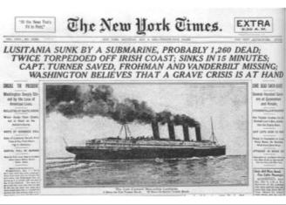
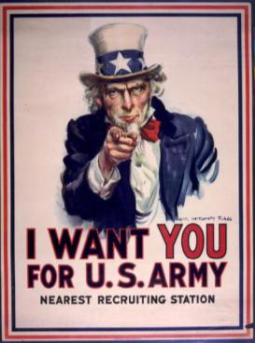
REASONS FOR WORLD WAR I
Densely populated European countries were economic and political rivals with one another. Ethnic conflicts, militarism, and the assassination of Austrian-Hungary Archduke Franz Ferdinand were causes of World War I. The US became involved after German U-boats sank the Lusitania ship carrying 128 Americans. US also feared Germany was trying to help Mexico invade the southern part of the United States known as the Zimmerman telegram.

Slide 8
REASONS FOR WORLD WAR I
European countries were economic and political rivals with one another. Austrian-Hungary Archduke Franz Ferdinand is assassinated by a Serbian nationalist causing allies and central powers to take sides and go to war (1914).
1917 U.S. Enters the war because: 1)German U-boats sank the Lusitania ship carrying 128 Americans. 2) U.S. intercepted a telegraph sent by Germany called the “Zimmerman Telegraph” asking Mexico to attack the U.S.

Slide 9
Georgia History 1/9/2019
SS8H8 Analyze Georgia’s participation in important events that occurred from World War I through the Great Depression.
a. Describe Georgia’s contributions to World War I.
Milestone #72
Learning Target: Today, I will be able to better understand how Georgia contriubuted to WWI by writing my “5”
CHECKING: WW1 THINKING MAP/REFLECTION
Day 2 notes: Causes of WWI
Students complete: 1) 5 point reflection 2) Ga.’s contribution to WWI thinking map 3) Vocab 4) What I know Thus Far 1-150

Slide 10
GEORGIA’S CONTRIBUTIONS
In 1917, The United States Enters World War I
Georgia helped win WWI by providing over 100,000 soldiers and many women volunteers.
Military camps around the state trained soldiers, pilots, and doctors and later became forts that are still used today for training.
Cotton grown in Georgia made uniforms and food was sent overseas to the troops.
On Nov. 11, 1918 the Allied Nations claimed victory, and the war ended.

Slide 11
Georgia History 1/30/2020
SS8H8 Analyze Georgia’s participation in important events that occurred from World War I through the Great Depression. b. Explain economic factors that resulted in the Great Depression. (e.g., boll weevil and drought).
Learning Target: Analyze Georgia's participation in key events from WWI through the Great Depression and determine the impact on the states economy.
Looking ahead: Complete textbook questons on pages 540 and 551
CHECKING: ONE ON ONE>3 Boll-weevil/Drought
Students complete: 1) Vocabulary 2) What I know Thus Far>stop at #150

Slide 12
Boll Weevil/Georgia Drought
1) What is a Boll-Weevil and where did it come from? Pg. 534
2) Explain how the boll-weevil destroyed cotton.
3) What impact did the boll-weevil have on African Americans? (handout)
4) Due to the destruction of the cotton crop, what did it force Georgia to do?( handout).
5) Before 1923, and the arrival of the boll-weevil, what was Georgia’s cotton production? What was it after 1923? Pg. 535
6) By 1987 explain why Georgia’s cotton production increased compared to 1983. ( handout)
7) What was another disaster that took place in 1920? (handout).
8) How long did the disaster you reference in question number 7 last?(handout)
9) Explain how this disaster impacted agricultural production.(handout).
10) Was Georgia already in a depression before the Great Depression happened in 1929? Explain. ( name the two disasters that caused it or not..found on the handout).

Slide 13
So What::________________________________________________________.
Georgia drought
Boll-weevil
So why:____________________________________________________________
__________________________________________________________________

Slide 14
GEORGIA’S CONTRIBUTIONS
In______, The United States Enters_____ War I
Georgia helped win______ by providing over______ soldiers and many women volunteers.
Military_____ around the state trained soldiers,______, and doctors and later became forts that are still used today for_______.
_______ grown in________ made uniforms and food was sent overseas to the troops.
On Nov. 11,_____ the______ Nations claimed victory, and the war ended.

Slide 15
GEORGIA’S CONTRIBUTIONS
Georgia helped win WWI by providing over 100,000 soldiers and many women volunteers. Military camps around the state trained soldiers, pilots, and doctors and later became forts that are still used today for training. There was also a prison camp that housed captured German soldiers. Cotton grown in Georgia made uniforms and food was sent overseas to the troops. Citizens bought Liberty Bonds and grew Victory Gardens to help.

Slide 16
REASONS FOR WORLD WAR I
__________ countries were economic and_______ rivals with one another. Austrian-______ Archduke______ Ferdinand is assassinated by a________ nationalist causing allies and _______ powers to take sides and go to war (1914).
______ U.S. Enters the war because: 1)German U-boats sank the_______ ship carrying____ Americans. 2) U.S. ________ a telegraph sent by________ called the “_______ Telegraph” asking______ to attack the U.S.

Slide 17
World War I
So What:_________________________________________________
________________________________________________________
So what?__________________________________________________.
What started WWI
IN EUROPE?
hat started WWI
IN EUROPE?
NAME TWO
REASONS FOR
U.S. ENTERING
WWI.
1.________________
_______________
2.________________
LIST 3 ADDITIONAL
FACTS ABOUT WWI
THAT IS NOT LISTED IN
YOUR NOTES:
1.___________________
2.___________________
3.___________________
List
thePIC
Alliance
powers
List
thePIC
Central
powers
PIC
PIC
PPIC
IC
PPIC
IC
SoSo Why:_________________________________________________
__________________________________________________________
__________________________________________________________ why?_____________________________________________________.

Slide 18
Georgia History Objective: 1/15/19
SS8H8 Analyze Georgia’s participation in important events that occurred from World War I through the Great Depression.
b. Explain economic factors that resulted in the Great Depression. (e.g., boll weevil and drought).
NO MILESTONE
Learning target: Today, I will take my quarter two bench mark assessment to better understand the areas in which I need work harder.
Checking: Vocab>1-5
Quarte 2: Bench Mark Assessment
Students complete: 1) Quarter 2 bench mark assessment 2) Vocab. 3) “ What I know Thus Far” 1-155

Slide 19
Today, I learned how Georgia contributed to WWI. First, being that Georgia is known for Cotton and agriculture, Georgia provided clothing and food to help with the war effort. For example, “Cotton grown in Georgia made uniforms and food was sent overseas to the troops.” (Caldwell 2018). I now know of at least two ways that Georgia contributed to the war effort.

Slide 20
R-RESTATE
A-ANSWER-STARTS WITH TRANSSTION WORD
C-CITE-STARTS WITH A TEXT EVIDENCE TERM
E-XPLAIN-CLOSING STATEMENT RE-EXPLAINING.
****HOW MUCH DAMAGE DID THE BOLL-WEEVIL CAUSE DURING THE EARLY 19TH CENTURY?
1920’s- GA is not enjoying America’s prosperity
Boll weevil: small beetle that hatches in the cotton flower-
Causes> Came from Mexico and Causes>migrated into the southern states 1892
Cause>eats the buds out of the cotton plants
Effects: Destroyed thousands of acres of cotton (production drops from 2.8 million bales to 600,000)
Many African Americans moved North/loss of jobs
Farmers were forced to diversify crops
$300 million in damage annually/$15 billion during the twentieth century.

Slide 21
Collaborative Research Pace Drill Due At The End of Class☺
Google>Title> “Boll Weevil” #1
What is it? #2
What did it do? #3
When did it appear? #4
Where did it come from? #5
How much damage it cause? #6
Draw ONE illustration #7
List one other interesting fact☺ #8
Create one choice thinking map/So What/So why #9

Slide 22
1932 picking cotton

Slide 23
Boll Weevil

Slide 24
. A) Describe the impact of the boll weevil and drought on Georgia
1920’s- GA is not enjoying America’s prosperity
Boll weevil: small beetle that hatches in the cotton flower-
Causes> Came from Mexico and Causes>migrated into the southern states 1892
Cause>eats the buds out of the cotton plants
Effects: Destroyed thousands of acres of cotton (production drops from 2.8 million bales to 600,000)
Many African Americans moved North/loss of jobs
Farmers were forced to diversify crops
$300 million in damage annually/$15 billion during the twentieth century.

Slide 25
Cause and Effect of the: Boll Weevil
SO WHAT:______________________.
CAUSES
EFFECTS
THE BOLL WEEVIL
SO WHY:_______________________.

Slide 26
. A) Describe the impact of the boll weevil and drought on Georgia
________- GA is not enjoying_________ prosperity
________ weevil: small______ that_______ in the cotton flower-
Came from_________ and migrated into the_______ states 1892
eats the______ out of the cotton______
Effect:_______ thousands of acres of______ (production drops from____ million_____ to 600,000)
______ African_______ moved North/____ of jobs
________ were forced to______ crops
______ million in______ annually/$15_____ during the twentieth________.

Slide 27
. A) Describe the impact of the boll weevil and drought on Georgia
1924- Major drought hits GA
Ruins GA’s crops
Farms fail- farm related businesses fail
Banks that lent money to farms can not collect causing huge losses
Boll weevil + drought- leads to GA’s depression

Slide 28
Collaborative Research Pace Drill Due At The End of Class☺
What does drought mean? #1
How long did the 1924 Georgia Drought last?#2
How can scarcity of water impact agriculture and industry? #3
What is meant by when a state goes into a “Depression”?#4
What two events caused Georgia to go into a depression?#5
Which rivers in Georgia did the Drought affect ? #6
Explain how migration is tied to both the drought, and the boll-weevil.? #7 Page 535 (read caption about the picture)
Draw ONE illustration of the 3 major rivers affected by the drought> #8
List one other interesting fact☺ #9
Create one choice thinking map/So what/So why #10

Slide 29
SO WHAT:____________________________________________________.
THE DROUGHT
SO WHY:________________________________________________________.

Slide 30
. A) Describe the impact of the boll weevil and drought on Georgia
_______- Major_________ hits GA
_______ GA’s_____
Farms_____- farm related_______ fail
Banks that lent_______ to farms can not_______ causing huge losses
Boll weevil +_______- leads to GA’s___________

Slide 31
Georgia History 1/18/2019
SS8H8 Analyze Georgia’s participation in important events that occurred from World War I through the Great Depression.
a. Describe Georgia’s contributions to World War I.
b. Explain economic factors that resulted in the Great Depression. (e.g., boll weevil and drought).
Learning Target: Today, I will be able to better understand how The Great Depression impacted Georgia by working with my group members on teacher provided collaborative research questions.
Day 5: Finalize and compare The Great Depression Collaborative Probing questions
Finalize Bench Mark Test
Students complete: 1) Splash/collaborative research questions 2) Vocab 3) “What I know Thus Far” 1-177

Slide 33
Stock Market Crash: The Beginning of The Great Depression
Stock Market Crash (1929)
Banks had purchased large amounts of stocks, after the crash, they lost money
Economic Factors that resulted in The Great Depression
High tariffs post WWI
Speculation in the Stock Market- prices of stocks increase, more than they are really worth
Explain economic factors that resulted in the Great Depression
Causes of the Great Depression:
People borrowed more money from the banks than they could repay (banks/business collapse)
Many factories had produced more goods than they could sell (over production)

Slide 34
Events leading up to WWII

Slide 35
The Great
Depression

Slide 36
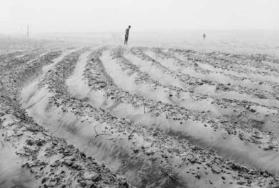
1924 Drought

Slide 37
Black Tuesday- New York Stock Market Crashed

Slide 38
Crowds gather and try to withdrawal their savings from the banks

Slide 39
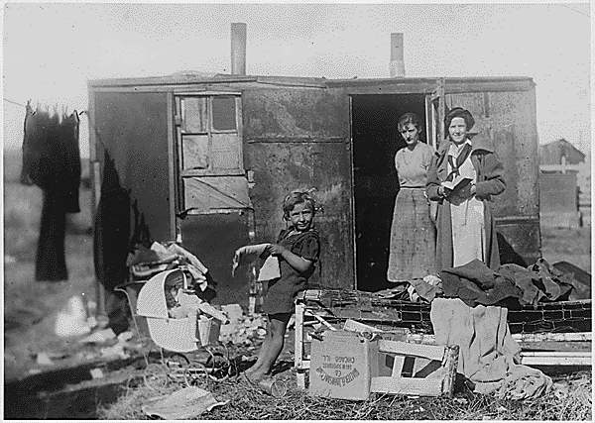
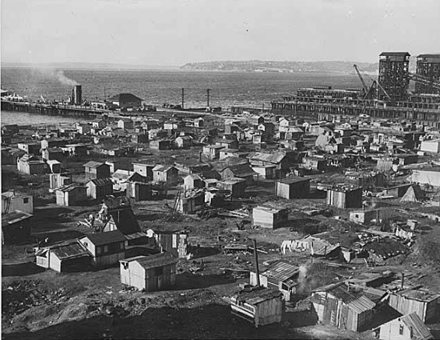
Little “Hoovervilles” people lost their homes and had to use any supplies available to build shelter. Herbert Hoover was president when the Depression began.

Slide 40
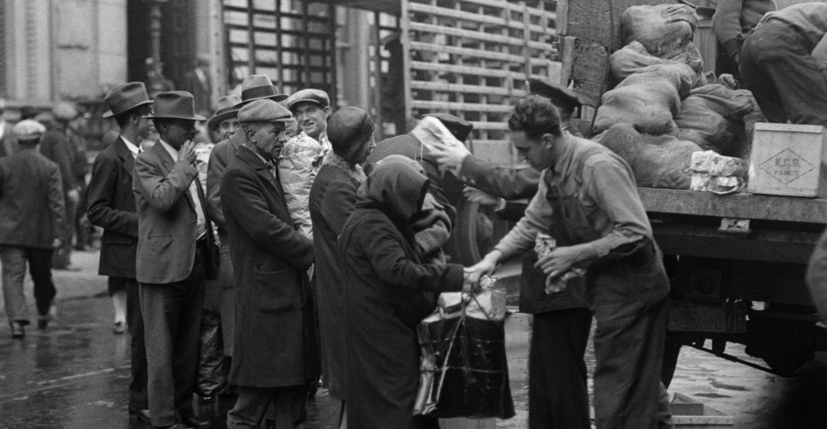
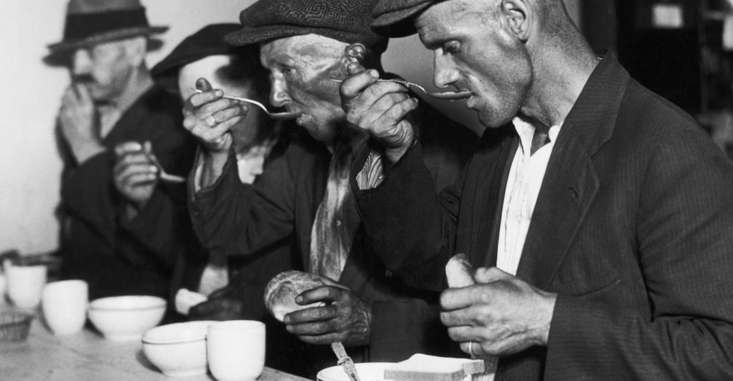
Unemployed Men Outside of a Soup Kitchen in Chicago, 1933

Slide 41
Collaborative Probing Research Questions: The Great Depression
What years did the Great Depression occur?
What is meant by “Black Tuesday”
Explain how the stock market crash marked the beginning of The Great Depression ( DOK ).
List two economic factors that contributed to The Great Depression (DOK).
Explain why banks failed ( DOK)
What happens when a factory over produces a product (DOK)
Explain how the United States recovered from The Great Depression

Slide 42
THE STOCK MARKET CRASH/THE GREAT DEPRESSION
SO WHAT:_____________________________________________
SO WHY: _____________________________________________>

Slide 43
Stock Market Crash: The Beginning of The Great Depression
Stock Market Crash (1929):
Banks had purchased_______ amounts of stocks, after the crash, they lost money
“Run on the banks” –causes the_________ to_______
Economic Factors that resulted in The Great Depression
High________ post WWI
Speculation in the Stock_______- prices of stocks increase, more than they are really _______
Banks purchasing_______ (lose it all after the______)
Laissez-faire__________: economy could_______ itself out of the depression
Explain economic factors that resulted in the Great Depression
Causes of the Great ___________:
People borrowed more money from the_______ than they could repay (banks/_______ collapse)
Many_______ had produced______ goods than they could sell (over production)
Farmers produce______ crops- European competition_________

Slide 44
Group Collaborative Research
Group 1: A)Explain what is meant by “Black Tuesday” B) Draw one illustration
Group 2: A) Define The Great Depression B) Draw one illustration
Group 3: A) How were Banks effected during the Great Depression B) Draw one illustration
Group 4: A) Explain what happened to the stock market in 1929 B) Draw one illustration
Group 5: A) How was Georgia effected by the Great Depression
Group 6: How many jobs were lost during the Great Depression B) Draw one illustration.
Group 7: A) List at least two causes of the Great Depression B) Draw one illustration

Slide 45
Directions: Create a song playlist about the topics discussed during the Great Depression lesson. Also, write a brief explanation of how the song relates to the topic.
© 2014 Brain Wrinkles

Slide 46
Directions: Write a news article that describes one of the major events from this time period. Add a catchy headline and an action shot.
!!
$
© 2014 Brain Wrinkles

Slide 47
Georgia History 1/22/19
SS8H9 Describe the role of Georgia in WWII.
a. Describe key events leading up to American involvement in World War II; include the Lend-Lease Act and the bombing of Pearl Harbor.
b. Evaluate the purpose and economic impact of the Bell Bomber Plant, military bases, and the Savannah and Brunswick shipyards.
c. Explain the economic and military contributions of Richard Russell and Carl Vinson.

Slide 48
Georgia History: 1/24/19
UNIT 6.5>SS8H8:Analyze Georgia’s participation in important events that occurred from World War I through the Great Depression> c. Describe Eugene Talmadge’s opposition to the New Deal Programs.
Learning Target: Today, I can explain how Eugene Talmadge felt about the New Deal Programs by completing my splash/collaborative research questions.
Milestone Practice Question #78
Group evaluations: Eugene Talmadge/cross check student notes with teacher notes
Day 6: Finalize Splash notes/collaborative research on Eugene Talmadge
Open note/summative assessment: WWI/BOLL-WEEVIL/DROUGHT/EUGENE TALMADGE/THE GREAT DEPRESSION.
Students complete: 1) Eugene Talmadge/splash collaborative questions 2) Vocab. 3) What I know Thus far 1-156

Slide 49
The New Deal Programs
Q- 1: What was the purpose of the Rural Electrification Act/draw one illustration
Q-2: How did F.D.R. come up with the idea of the Rural Electrification: Google REA and Warm Springs/ Act/Draw one illustration
Q-3: What was the purpose of the Social Security Act/Draw one illustration
Q- 4: The Social Security Act was meant to help people who ______? Draw one illustration.
Q-5-What was the purpose of the Civilian Conservation Corps, and list one job that was created.
Q-6: What was the purpose of the Agricultural Adjustment Act?
Q-7: Find one other new deal program we have not discussed and explain it’s purpose/Draw an illustration
Q-8: Find one other New Deal Program not discussed, and list 4 facts about it
Q-9: Choice thinking map/So what/So why

Slide 50
1932- Franklin D. Roosevelt is elected president- “promises new deal for the American people”
New Deal- Purpose
Promote economic recovery
Relieve the suffering of the unemployed
Reform defects in the economy
Improve society
Civilian Conservation Corps (CCC): provided jobs building roads, trails, parks, planting trees, and control flooding
Popular in GA with work on Kennesaw Mountain National Battlefield and many other projects
Agricultural Adjustment Act (AAA): paid farmers not to plant crops on part of their land
Created price supports (guaranteed higher prices) to farmers who agreed to cut back their cotton/tobacco crops
Idea was to raise farm prices by limiting production
It worked, farm income improved in GA
Rural Electrification: provided power to rural areas in GA, not just towns/cities
One of the most important and far reaching New Deal programs
Result of Roosevelt’s experience in Warm Springs
Helped GA farmers modernize their farms
Social Security Act: The federal government would provide retirement and unemployment insurance from taxes paid by both the workers and employers.
Farmers not covered
The idea: to provide protection from unemployment

Slide 51
Collaborative Research
Q1: Who was Eugene Talmadge?
Q-2: Which group of people did Eugene Talmadge support when he was a governor?
Q-3: Where did he stand on Civil Rights?
Q-4: What was his stance on Integration?
Q-5:How did he feel about Franklin D. Roosevelt’s New Deal programs?
Q-6:List 4 other facts about Eugene T.
Q-7: Create a choice thinking map/So What/So Why
Q-8: Write a 5 point reflection
Q-9: Draw one illustration that best Eugene T.

Slide 52
A-B-C DIRECTIONS
Directions for completing thinking maps:
Group A – Complete the exact thinking map on the board. Provide three facts, one picture, and complete the so what, and so why. You may use your phone or textbook for research.
Group B – Complete the exact thinking map as shown on the board. Provide at least four facts and two pictures. Complete the so what and so why. You may use your phone or textbook for research.
Group C - Create a thinking map of your choice using the topics on the board. Your thinking maps must have at least six facts, two pictures, and explanation of so what and so why. Color your pictures. You may use your phone or textbook for research.

Slide 53
C) Discuss the impact of the political career of Eugene Talmadge
Eugene Talmadge, a powerful Georgia politician, opposed many of the New Deal programs.
Talmadge served as Georgia’s governor from 1933-1937 and from 1941-1943.
He appealed to Georgia’s rural farmers and they backed him passionately.
Talmadge opposed civil rights for African Americans and fought against integration of schools.
Talmadge believed that the federal government should stay out of state matters and he refused to back many of Roosevelt’s policies.

Slide 54
SO WHAT_____________________.
PIC
POLITCS
PIC
Eugene Talmadge
POSITIVES
PIC
NEGATIVES
SO WHY_________________________.

Slide 55
C) Discuss the impact of the political career of Eugene Talmadge
Eugene________, a powerful Georgia_________, opposed many of the_________ Deal programs.
Talmadge_______ as Georgia’s_______ from 1933-1937 and from _______-1943.
He appealed to Georgia’s________ farmers and they backed him__________.
Talmadge opposed_______ rights for African Americans and________ against________ of schools.
Talmadge believed that the______ government should stay out of state matters and he_________ to back many of Roosevelt’s________.

Slide 57
Reverse Learning ☺
The Boll Weevil migrated from where?
What economic impact $$$ did the Boll Weevil have on Georgia Farmers?
How long did the Drought in Georgia last?
What stance did Eugene Talmadge take on integration?
Did Eugene Talmadge support F.D.R’s New Deal programs?

Slide 58
Georgia History 3/1/2018
STANDARD(S): SS8H8 The student will analyze the important events that occurred after World War I and their impact on Georgia. A) Describe the impact of the boll weevil and drought on Georgia. B) Explain economic factors that resulted in the Great Depression. C) Discuss the impact of the political career of Eugene Talmadge. D) Discuss the effect of the New Deal in terms of the impact of the 1)Civilian Conservation Corps, 2)Agricultural Adjustment Act, 3)rural electrification, 4)Social Security.
Learning Target: Today, I can assess my mistakes on unit 6 test by completing my corrections
Unit 6 Test Corrections/Remiation:1) 90-100>Correct each answer 1 time, 2) 80-89> Correct each answer 2 times 3) 70-79> 3 times 4) 69-Below 4 times
Introduce WWII Projects
Students complete: 1) WWII projects 2) Thinking map 3) Reflections 4) Vocab. 5) What I know Thus Far 1-181

Slide 59
. D) Discuss the effect of the New Deal in terms of the impact of the Civilian Conservation Corps, Agricultural Adjustment Act, rural electrification, Social Security.
Rural Electrification: provided power to rural areas in GA, not just towns/cities
One of the most important and far reaching New Deal programs
Result of Roosevelt’s experience in Warm Springs
Helped GA farmers modernize their farms
Social Security Act: The federal government would provide retirement and unemployment insurance from taxes paid by both the workers and employers.
Farmers not covered
The idea: to provide protection from unemployment

Slide 60
Pictures
Pictures
Pictures
Pictures
1)Civilian Conservation Corps
2)Agricultural Adjustment Act
3)rural electrification
4)Social Security.
So Why:______________________________________
So What:______________________________________

Slide 61
. D) Discuss the effect of the New Deal in terms of the impact of the Civilian Conservation Corps, Agricultural Adjustment Act, rural electrification, Social Security.
1932- Franklin D.____________ is elected president- “_________ new deal for the American people”
New Deal- Purpose
Promote________ recovery
Relieve the_______ of the unemployed
Reform_______ in the economy
_______ society
Civilian Conservation Corps (CCC): provided jobs building______, trails, parks, planting _______, and control _________
Popular in ___ with work on________ Mountain National_________ and many other projects
Agricultural Adjustment Act (AAA): _____ farmers not to _____crops on part of their land
Created______ supports (guaranteed_________ prices) to farmers who agreed to cut back their cotton/tobacco crops
Idea was to________ farm prices by _______ production
It worked, _______income improved in GA

Slide 62
. D) Discuss the effect of the New Deal in terms of the impact of the Civilian Conservation Corps, Agricultural Adjustment Act, rural electrification, Social Security.
Rural Electrification: provided______ to rural areas in GA, not just_________/cities
One of the most important and far reaching______ Deal programs
Result of________ experience in Warm Springs
Helped GA________ modernize their farms
Social Security Act: The federal__________ would provide________ and________ insurance from taxes paid by both the workers and_________.
Farmers not covered
The ____: to provide_________ from unemployment

Slide 63
Checking for Understanding
1. What impact did the boll weevil have on the South’s economy?
2. How did drought impact Georgia’s farms in the 1920s?
3. What happened on October 29, 1929?
4. What was the severe downturn of the US economy during the 1930s called?
5. Where did many Georgia farmers go to find work?

Slide 64
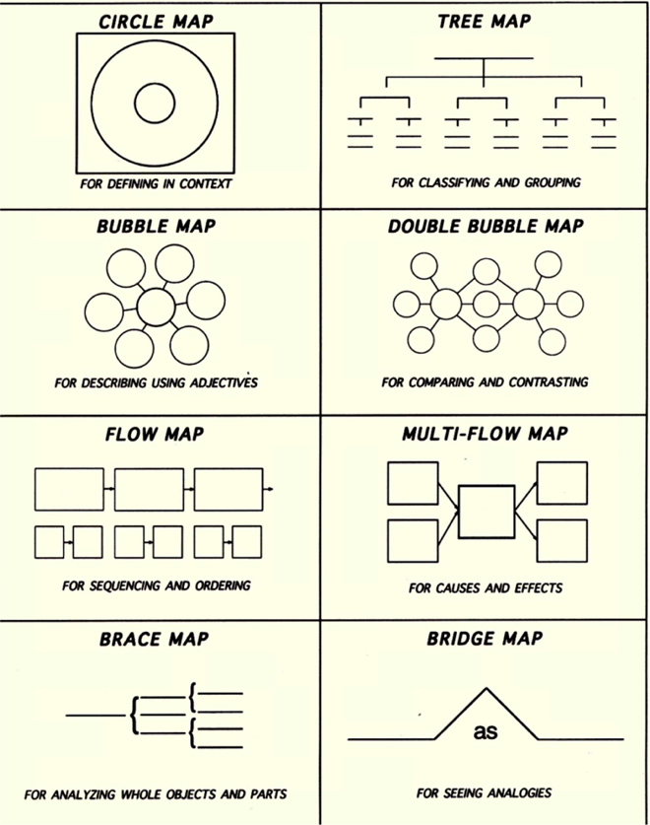

Slide 65
1932- Franklin D. Roosevelt is elected president- “promises new deal for the American people”

Slide 66
CCC Workers Building Telephone Poles

Slide 67
President Franklin D. Roosevelt talking with Georgia Farmers

Slide 70
Directions: You are the doctor! Write a prescription to cure the “ailments” of the Great Depression.
T
Name: ______________________
MD Signature:___________________________________
Ailment: The Great Depression>brief diagnose
Prescription cure : New Deal Define: Pg. 391>
Medications>pg. 393>
DONE
© 2014 Brain Wrinkles

Slide 71
President Roosevelt Signing Social Securities Act (Part of the New Deal Plan) 1935

Slide 72
GEORGIA ACRONYM REVIEW
ac·ro·nym: an abbreviation formed from the initial letters of other words and pronounced as a word (e.g., ASCII, NASA).
GROUP A: COPY THE ACRONYM AS IS/DRAW ONE ILLUSTRATION PER REVIEW
GROUP B: MAKE UP YOUR OWN ACRONYM FOR EACH REVIEW/DRAW ONE ILLUSTRATION FOR EACH REVIEW
GROUP C: MAKE UP YOUR OWN ACRONYM PER REVIEW/WRITE ONE COMPLETE SENTENCE FOR EACH REVIEW

Slide 73
A-B-C DIRECTIONS
Directions for completing thinking maps:
Group A – Complete the exact thinking map on the board. Provide three facts, one picture, and complete the so what, and so why. You may use your phone or textbook for research.
Group B – Complete the exact thinking map as shown on the board. Provide at least four facts and two pictures. Complete the so what and so why. You may use your phone or textbook for research.
Group C - Create a thinking map of your choice using the topics on the board. Your thinking maps must have at least six facts, two pictures, and explanation of so what and so why. Color your pictures. You may use your phone or textbook for research.

Slide 74
CHECKING FOR UNDERSTANDING
Which New Deal program encouraged farmers not to plant crops?
Which New Deal program built state parks?
How long did the Great Depression last?
Who was the president that brought the United States into the Great Depression?
Who was the president that brought the United States out of the Great Depression?

Slide 75
2/28/2017 Georgia History
STANDARD(S): SS8H8 The student will analyze the important events that occurred after World War I and their impact on Georgia. A-Tuesday) Describe the impact of the boll weevil and drought on Georgia. B-Wed) Explain economic factors that resulted in the Great Depression. C) Discuss the impact of the political career of Eugene Talmadge. D) Discuss the effect of the New Deal in terms of the impact of the Civilian Conservation Corps, Agricultural Adjustment Act, rural electrification, Social Security Act.
Learning Target: Today, I assess my mistakes made on Unit 8 summative assessment by completing my test corrections.
Milestone Review
Checking “What I know Thus Far” 52-72
Due Today: Milestone Review Questions Chapters 10-11
UNIT 8 PART 2>TEST CORRECTIONS:A) 90-100> 1 TIME B) 80-89>2 TIMES C) 70-79>3 TIMES D) 60-69>4 TIMES F) 50-59>5 TIMES
Students complete: 1) All Thinking Maps 2) What I know Thus Far 1-182

Slide 76
Background building
How did the idea of the Rural Electrification Act come about?
List one task the REA was most famous for?
What was the purpose of the Social Security Act?
Who benefited from the Social Security Act?
How was the Social Security Act funded?

Slide 77
Georgia History 1/6/19
SS8H9 Describe the role of Georgia in WWII.
a. Describe key events leading up to American involvement in World War II; include the Lend-Lease Act and the bombing of Pearl Harbor.
b. Evaluate the purpose and economic impact of the Bell Bomber Plant, military bases, and the Savannah and Brunswick shipyards.
c. Explain the economic and military contributions of Richard Russell and Carl Vinson.
Learning Target: Today, I will be able to better understand the events caused American involvement in WWII by working with my group on our probe questions.
Milestone #86
SPLASH/WWII/COLLABORATIVE RESEARCH GROUP WORK
DAY1: WWII/EVENTS LEADING TO AMERICAN INVOLVEMENT
STUDENTS COMPLETE: 1) DAY ONE PROBE QUESTION>AMERICAN INVOLVEMENT WWII 2) VOCAB 3) WHAT I KNOW THUS FAR

Slide 78
Georgia History 2/15/19
SS8H9 Describe the role of Georgia in WWII.
a. Describe key events leading up to American involvement in World War II; include the Lend-Lease Act and the bombing of Pearl Harbor.
b. Evaluate the purpose and economic impact of the Bell Bomber Plant, military bases, and the Savannah and Brunswick shipyards.
c. Explain the economic and military contributions of Richard Russell and Carl Vinson.
Learning Target: Today, I will be able to better understand how Georgia contributed to WWII by completing my collaborative splash no
Finalize all evaluations
Finalize fill in the blank assessments/Great Depression/New Deal/WWI/WWII/Ga and WWII/key People
Looking ahead: Students complete looking ahead questions for future probe questions
Students complete: 1) Fill in the blank assessment 2) Complete looking ahead questions

Slide 80
SS8H9 Describe the role of Georgia in WWII. a. Describe key events leading up to American involvement in World War II; include the Lend-Lease Act and the bombing of Pearl Harbor. b. Evaluate the purpose and economic impact of the Bell Bomber Plant, military bases, and the Savannah and Brunswick shipyards. c. Explain the economic and military contributions of Richard Russell and Carl Vinson.
Probe 1: How did Georgia’s economy grown as a result of WWII?
Probe 2: Name at least two military bases that contributed to the WWII effort in Georgia.
Probe 3: Which military base was considered the largest and the best in Georgia during WWII?
Probe 4: Do any of any of these bases contribute to Georgia’s economy today? If so, give real data☺
Probe 5: How did Bell Aircraft contribute to WWII?
Probe 6: What is Bell Aircraft called today and where is it located?
Probe 7: Name two of Georgia’s Sea ports that contributed to WWII.
Probe 8: How did Georgia’s sea ports contribute to WWII?
Probe 9: Where was the Liberty ship built, and how did it contribute to WWII?
Probe 10: Create a choice thinking map/So what/So Why/one illustration
Probe 11: Independent 5 point reflection.

Slide 81
Cont’d YESTERDAY’S PROBES
Probe 12: What political positions did Richard B. Russell hold in Georgia?
Probe 13: Where did Richard B. Russell graduate college from?
Probe 14:While serving as a senator, Richard B. Russell served on which committee?
Prob15: What was Richard B. Russell’s stance on building military bases in Europe?
Probe 16: Richard B. Russell was responsible for bringing or maintaining how many military bases in Georgia?
Probe 17: What influence did Richard B. Russell have on the Center for Disease Control ?
Probe:18 Where was Carl Vinson Born, and where did he attend college?
Probe 19: What political position was Carl Vinson elected to in Georgia?
Probe 20: Which committee did Carl Vinson serve on while he was a congressman?
Probe 21: What prestigious award did Carl Vinson receive from the president?
Probe 22: Are there any vessels named after Carl Vinson?
Probe: 23:Choice Reflection: Carl Vinson or Richard B. Russell

Slide 82
SS8H9 Describe the role of Georgia in WWII. a. Describe key events leading up to American involvement in World War II; include the Lend-Lease Act and the bombing of Pearl Harbor
Probe 1: How was Germany doing economically after WW1?
Probe 2: Which dictator came to power in Germany after WW!/What did he promise to do?
Probe 3: Which dictator from Germany ignored the WWI Treaty of Versailles/what was his intentions?
Probe 4: Name the 3 main Axis powers of WWII
Probe 5: What does Nationalism and Militarism mean?
Probe 6: What policy did the United States follow after WWII broke out in Europe?
Probe 7: How did the United States help it’s allies indirectly?
Probe 8: Why did the United States get involved in WWII?
Probe 9: Where did Japan attack on Dec. 7, 1941/how many deaths
Probe 10: What president asked congress to declare war?
Probe 11: Choice thinking map/:So what/So why
Probe 12: Independent 5 point refection

Slide 83
Events leading to WWII
After WWI, Germany’s economic hard times helped the National Socialist (Nazi) Party come to power.
Adolph Hitler becomes the dictator and leader of Germany and promises to return it’s country to a super power
In 1939, Hitler’s Nazi army invaded Poland – this was the last straw for the Allies.
Hitler completely ignored the terms of the Treaty of Versailles that ended WWI
Axis powers begin to flex their muscles through Nationalism and Militarism ( (Germany, Italy, Japan)
When WWII broke out in Europe in 1939, the US followed a policy of neutrality, which meant that they wouldn’t join either the Axis or Allied powers
Even though the US remained neutral in terms of fighting, President Roosevelt and Congress passed the Lend-Lease Act in 1941-supplying weapons and arms for our allies
Everything changed on December 7, 1941, when Japanese airplanes made a surprise attack on the US naval base at Pearl Harbor, Hawaii.
President Roosevelt asked Congress to declare war on Japan President Roosevelt asked Congress to declare war on Japan.

