Slide 2
World War 1
through the
GREAT
DEPRESSION
© Brain Wrinkles

Slide 3
Georgia’s Contributions to
WORLD WAR I
SS8H8a
© Brain Wrinkles

Slide 4
Military
Georgia contributed to World War I in many ways, including food production, textile manufacturing, and military involvement.
Nearly 100,000 Georgians served in the armed forces.
Over 3,000 of Georgia’s soldiers lost their lives during the war.
© Brain Wrinkles

Slide 5
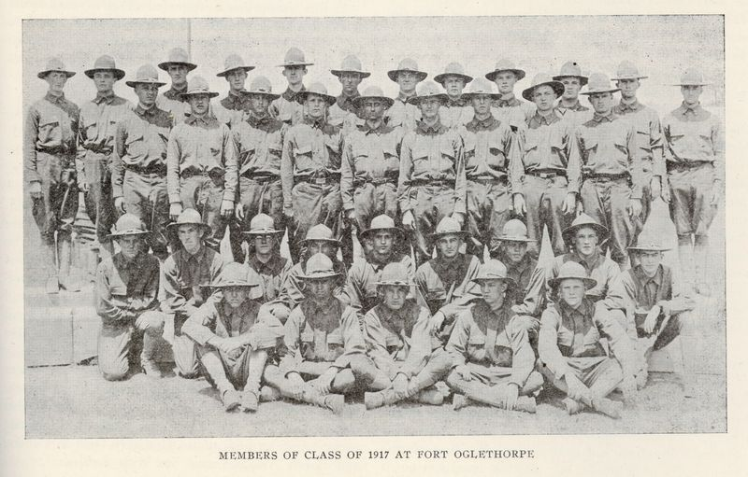
© Brain Wrinkles

Slide 6
Military
Georgia had more military facilities than any other state.
Georgia was home to five military camps at the start of the war, and added more by they time it was over.
The facilities were Fort McPherson, Fort Gordon, Fort Oglethorpe, Camp Wheeler, and Camp Hancock.
The camps were used to either train troops, help wounded soldiers, or house prisoners of war.
© Brain Wrinkles

Slide 7
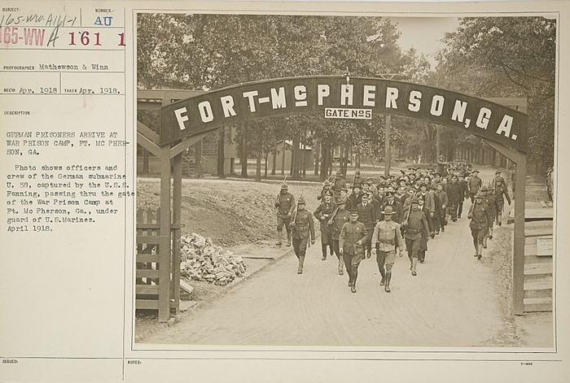
Fort McPherson in Atlanta trained new soldiers, held prisoners of war, and treated wounded soldiers.
© Brain Wrinkles

Slide 8
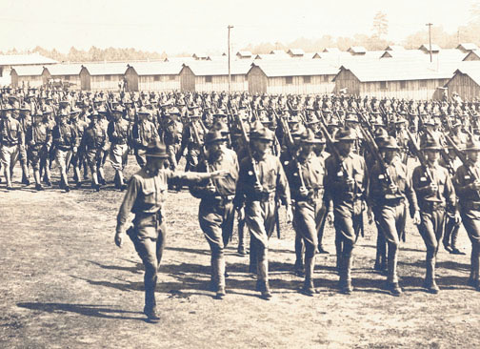
Fort Oglethorpe in North Georgia held prisoners of war.
© Brain Wrinkles

Slide 9
Cotton
During World War I, the increased demand for cotton brought prosperity to Georgia’s farmers.
The value of Georgia’s cotton crop tripled between 1900 and 1916—making farmers more prosperous than they had been in over 60 years.
Georgia’s cotton was used to make uniforms for soldiers in the state’s textile mills.
© Brain Wrinkles

Slide 10
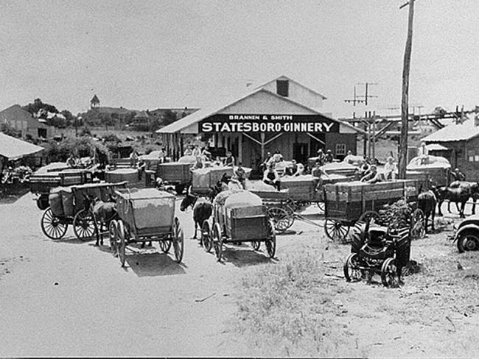
Wagonloads of Cotton in Statesboro
© Brain Wrinkles

Slide 11
Textiles
Georgia’s textile mills manufactured fabric that was used to make clothing, blankets, and bandages for soldiers.
Throughout the war, fabric was in high demand for military purposes, so more textiles mills were built throughout Georgia.
© Brain Wrinkles

Slide 12
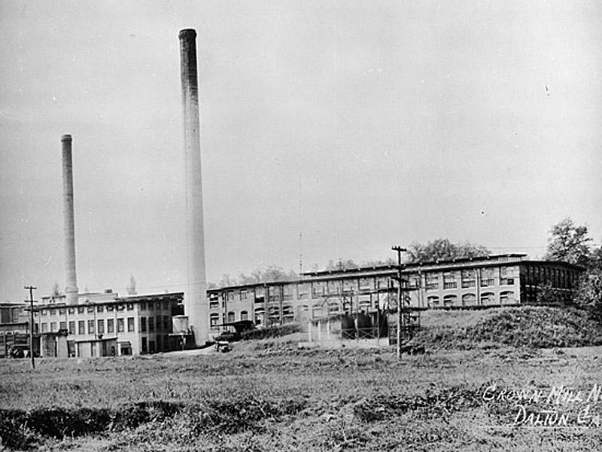
Crown Cotton Mill in Dalton – 1920s
© Brain Wrinkles

Slide 13
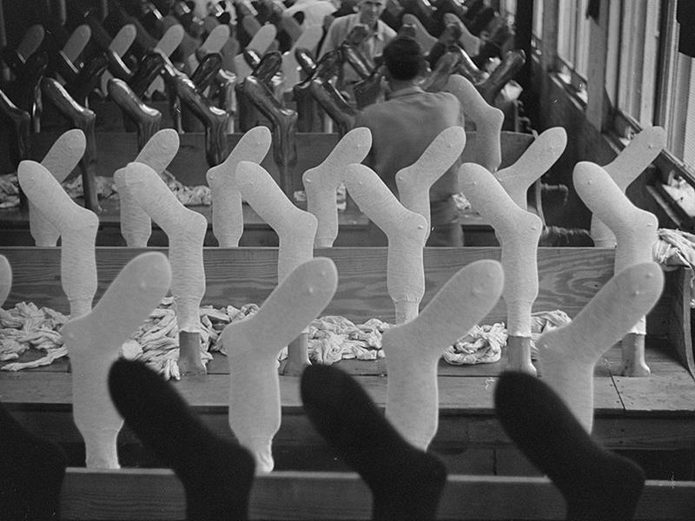
Hosiery Mill in Union Point Produces Socks.
© Brain Wrinkles

Slide 14
Agriculture
There was an increased demand for food production during the war as soldiers overseas needed food supplies.
Georgia’s cotton farmers began to grow huge quantities of fruit and vegetables.
Food products like peaches and sweet potatoes were canned in newly built canning factories across the state.
Meat was also processed in Georgia’s meat packing factories before being sent overseas.
© Brain Wrinkles

Slide 15
Rationing
During the war, much of the consumer goods were limited to only what was necessary for survival.
The government put wartime rationing on everything from sugar, coffee, meat, butter, shoes, to gasoline.
Many people started their own “victory gardens” in order to have fresh fruit and vegetables to eat at home, while saving canned foods to ship to soldiers overseas.
© Brain Wrinkles

Slide 16
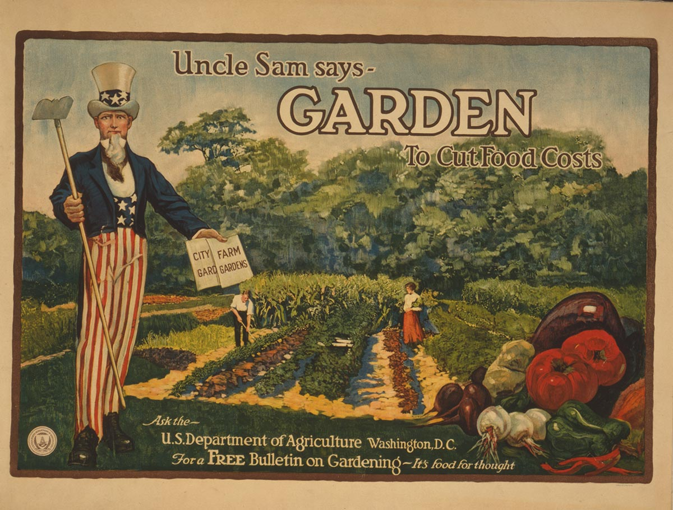
© Brain Wrinkles

Slide 17
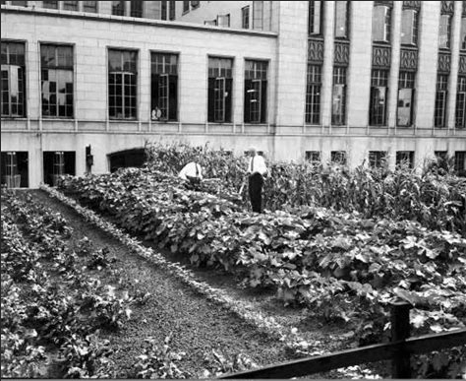
Victory Garden in Downtown Atlanta
© Brain Wrinkles

Slide 18
Economic Factors Leading to the
GREAT DEPRESSION
SS8H8b
© Brain Wrinkles

Slide 19
After the War
After WWI, many people enjoyed good economic times.
Increased industrialization left many Americans wealthy.
Unfortunately, farmers, like the majority of Georgians, still faced many challenges.
© Brain Wrinkles

Slide 20
Diversify
In addition to calling for more industry in Georgia, agriculture experts and New South businessmen urged farmers to diversify their crops.
Georgia’s farmers relied heavily on cotton and refused to take the advice.
They kept growing cotton (and only cotton) because it was the most profitable.
© Brain Wrinkles

Slide 21
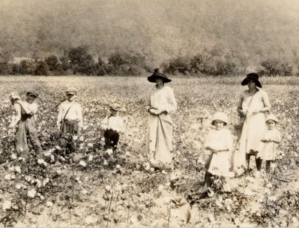
Picking Cotton near Marietta – 1930s
© Brain Wrinkles

Slide 22
Boll Weevil
A tiny, destructive insect known as a boll weevil made its way north from Mexico and reached Georgia’s farms in 1915.
The boll weevil was devastating to the South because it laid its eggs in cotton plants and the larvae destroyed the cotton bolls.
© Brain Wrinkles

Slide 23
Boll Weevil
© Brain Wrinkles

Slide 24
Destruction
By the 1920s, many Georgia farmers had lost their crops, money, and their land due to the insects’ destruction.
The total cotton crop dropped from 1.75 million bales a year to 588,000 in 1923.
Georgia’s cotton farmers were devasted, cotton was no longer “king”, and the destruction of the cotton crop forced farmers to finally diversify.
© Brain Wrinkles

Slide 25
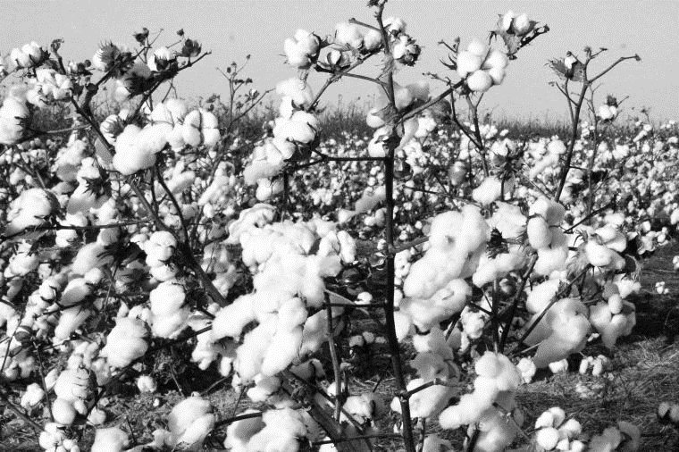
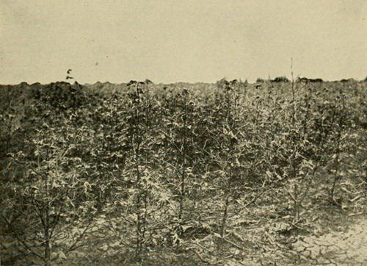
Boll Weevil Destruction
Healthy Cotton
© Brain Wrinkles

Slide 26
Drought
A severe drought soon followed the boll weevil catastrophe from 1924 to 1927.
Without enough rain, farmers could not grow as much as they normally did.
With the damage caused by the boll weevil and the droughts, Georgia began to suffer from a depression long before the rest of the United States.
© Brain Wrinkles

Slide 27
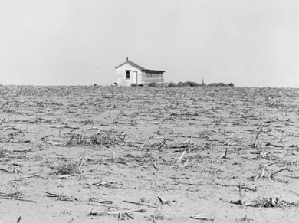
© Brain Wrinkles

Slide 28
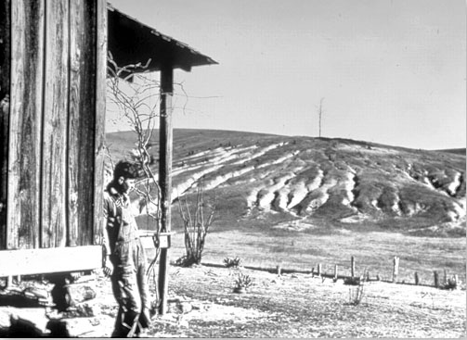
The severe drought led to soil erosion across Georgia.
© Brain Wrinkles

Slide 29
Changes
Both the boll weevil and the drought had a severe impact on Georgia’s agriculture and led to many changes in the state.
Cotton no longer became Georgia’s primary agricultural product, and farmers produced other goods including peaches, peanuts, and pecans.
Also, tobacco soon became one of Georgia’s most vital crops.
© Brain Wrinkles

Slide 30
Changes
The drought and boll weevil forced many of Georgia’s farmers to abandon their farms.
Between 1920 and 1925, so many farmers fell into debt that Georgia lost 60,000 farms.
Awful agricultural conditions caused more and more people to migrate to Georgia’s cities or to the North to find employment.
© Brain Wrinkles

Slide 31
Consumerism
While farmers suffered, the majority of the rest of the nation enjoyed prosperity during the 1920s.
People’s spending habits changed as they focused more on buying things rather than on saving.
Buying things on credit also became more common, which allowed people to buy things right away rather than having to save to afford them.
© Brain Wrinkles

Slide 32
Overproduction
Meanwhile, industries and businesses were producing more than people could buy.
Farmers were also producing more than people could use.
With WWI over, prices for crops fell drastically, making it hard for farmers to earn a profit.
Many farmers had to borrow money from banks to buy new equipment and grow more crops.
© Brain Wrinkles

Slide 33
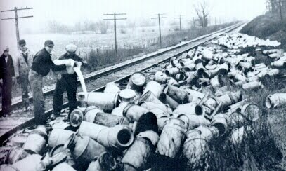
Dairymen Dumping Out Wasted Milk
Farmers continued to massive amounts of food, but the people weren’t buying it. Farmers were forced to destroy tons and tons of food.
© Brain Wrinkles

Slide 34
Stocks
More and more people began buying stocks.
When people buy stock, they purchase part ownership in companies that they believe will make money.
When the companies do well, the stockholders grow wealthy.
During the 1920s, people often paid for part of a stock and then borrowed money from banks to buy the rest.
© Brain Wrinkles

Slide 35
Stocks
In the 1920s, millions of Americans bought stocks on speculation.
That meant they hoped the price of shares in companies would go up.
This sent the price of stocks up more than they were really worth.
© Brain Wrinkles

Slide 36
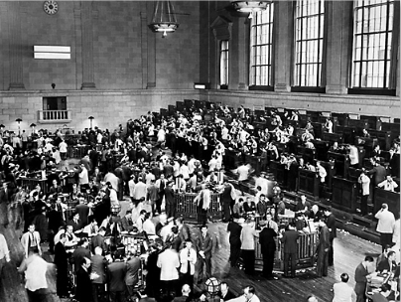
New York Stock Exchange – 1920s
© Brain Wrinkles

Slide 37
Black Tuesday
When stocks began to drop to their true worth, people panicked and sold their stocks for much cheaper prices.
This caused the stock prices to drop rapidly, and on October 29th, 1929, the stock market crashed.
This is known as “Black Tuesday” and marked the beginning of the Great Depression.
© Brain Wrinkles

Slide 38
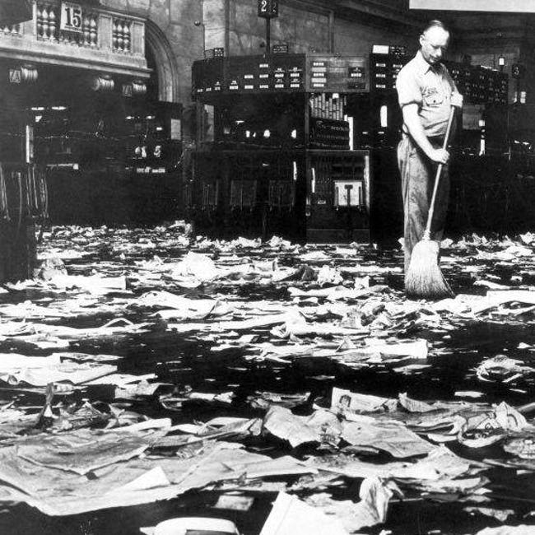
Floor of the NYSE after Black Tuesday.
© Brain Wrinkles

Slide 39
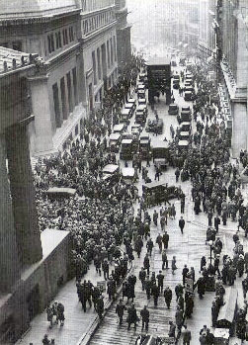
Crowd Gathering Outside the NYSE after the Crash in 1929.
© Brain Wrinkles

Slide 40
Crash
The depression that followed the stock market crash hurt many Americans.
People who were rich one day were poor the next.
Many banks went out of business, unemployment rose sky high, and thousands of people lost their life savings and their homes.
© Brain Wrinkles

Slide 41
Banks
During the early 1900s, there was no insurance protecting bank deposits.
After the stock market crashed, people rushed to banks to withdraw their money.
The banks quickly ran out of money, which caused many people to lose their entire life savings.
© Brain Wrinkles

Slide 42
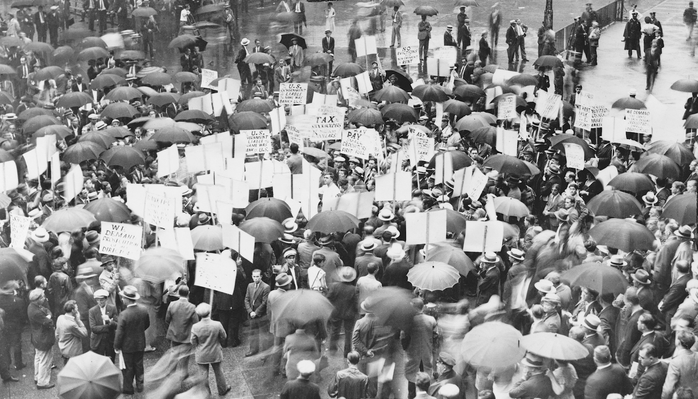
Crowds Outside of the Bank of the United States in NYC after its Failure in 1931.
© Brain Wrinkles

Slide 43
Depression
The Great Depression was the longest period of unemployment and low economic activity in modern times.
It began in 1929 and lasted throughout the 1930s.
Agriculture income dropped 50%, 25% of Americans were unemployed, and poverty and homelessness were widespread.
© Brain Wrinkles

Slide 44
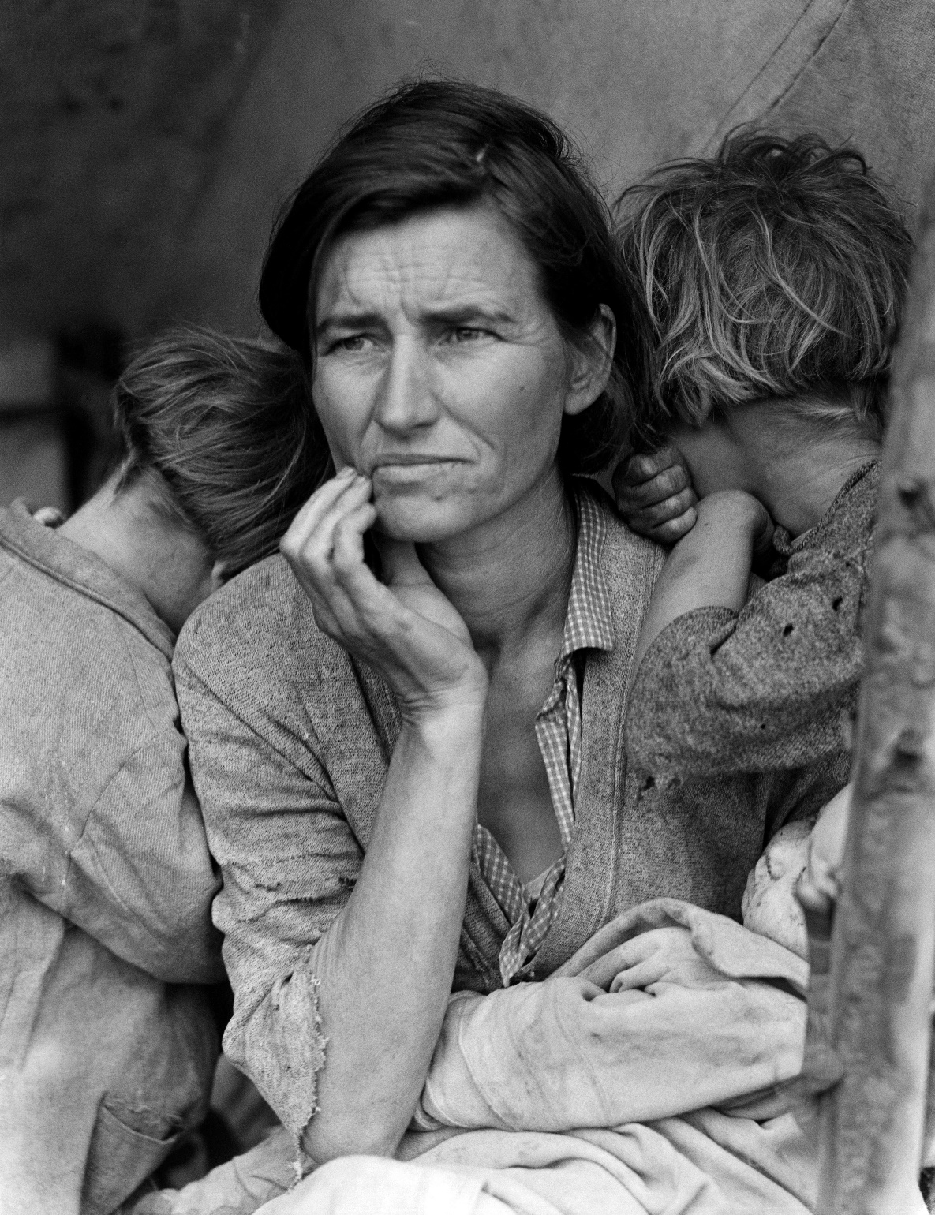
Dorothea Lange’s Migrant Mother depicts poor pea pickers in California. This is Florence Owens Thompson, age 32, a mother of seven children, in March 1936.
© Brain Wrinkles

Slide 45
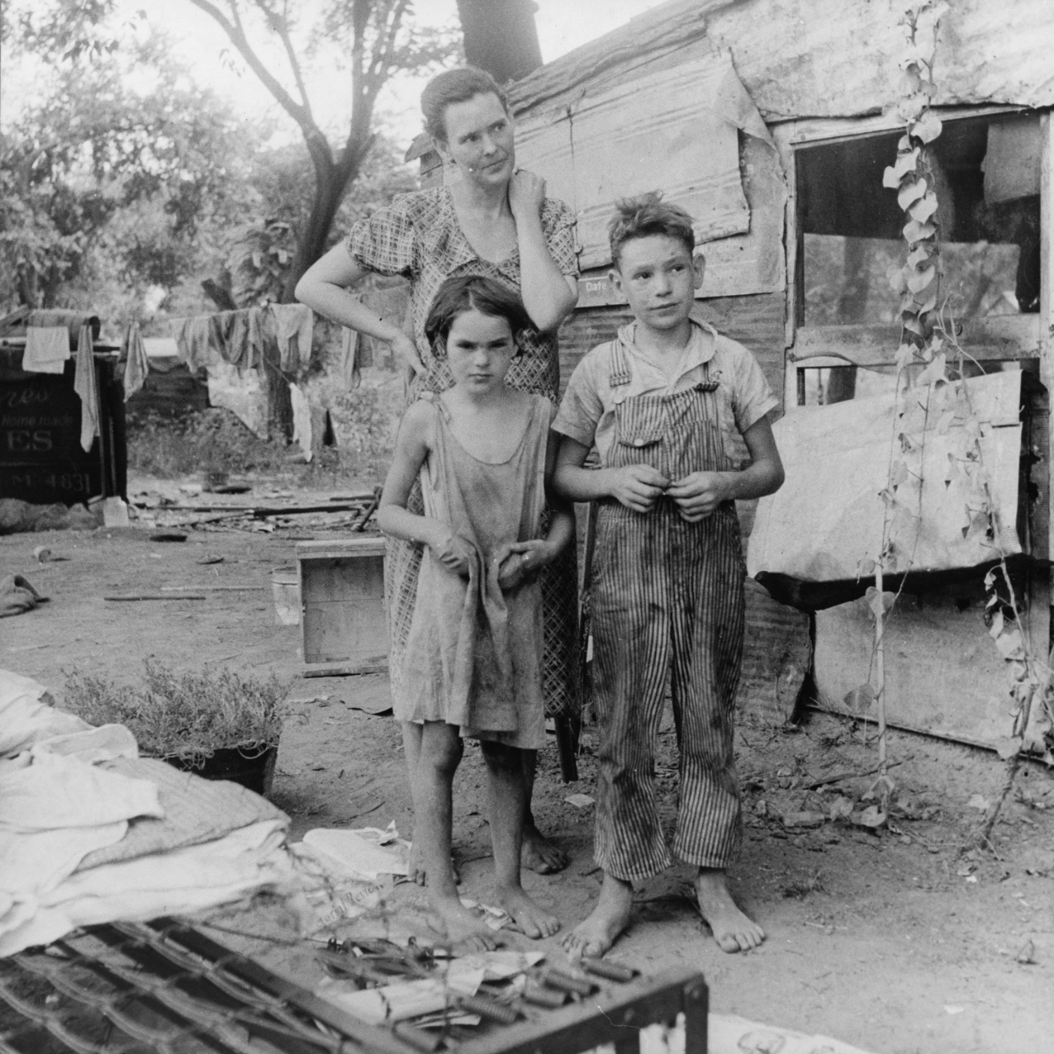
Impoverished American Family Living in a Shanty – Oklahoma, 1936
© Brain Wrinkles

Slide 46
Georgia
The Depression hit Georgia especially hard.
Cotton dropped to 5 cents per pound and within a year, many farmers lost their land and moved to cities to find work.
Between 1900 and 1940, Atlanta’s population grew by 200,000.
Many sharecroppers and tenant farmers, many of which were African American, left Georgia altogether and headed for northern cities.
© Brain Wrinkles

Slide 47
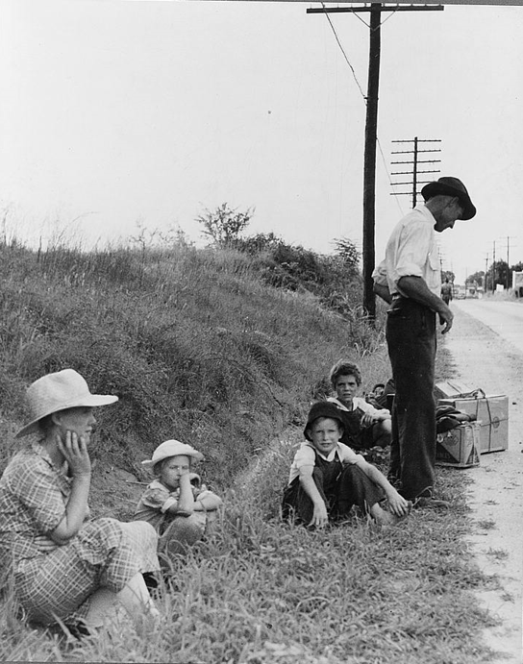
Family Hitchhiking to Macon in Search of Work
© Brain Wrinkles

Slide 48
The
NEW DEAL
SS8H8e
© Brain Wrinkles

Slide 49
Hoover
Herbert Hoover was president when the Depression began.
He believed that private charities and local communities should help the needy; it wasn’t the national government’s job to help.
Many people believed he did not do enough to help Americans during the Depression.
© Brain Wrinkles

Slide 50
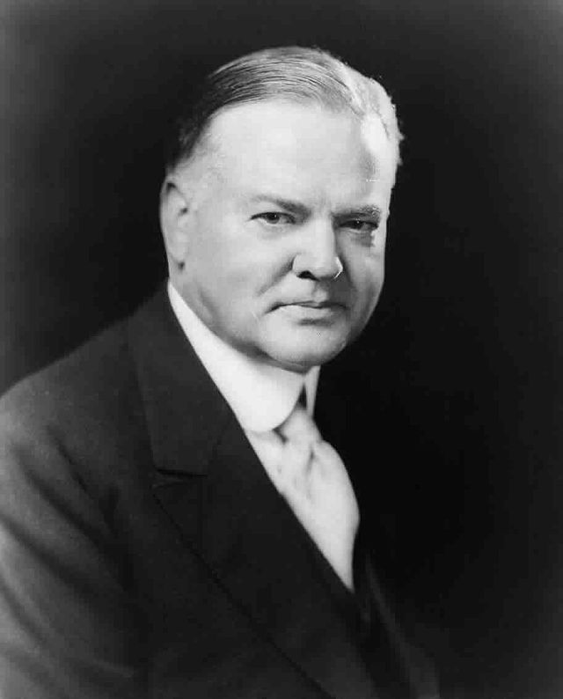
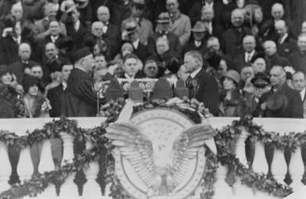
© Brain Wrinkles

Slide 51
Roosevelt
A new president, Franklin Delano Roosevelt, was elected in 1932.
He introduced a plan to get the country out of the Great Depression and promised a “New Deal” for the American people.
FDR’s government took an active role in trying to help the economy recover.
© Brain Wrinkles

Slide 52
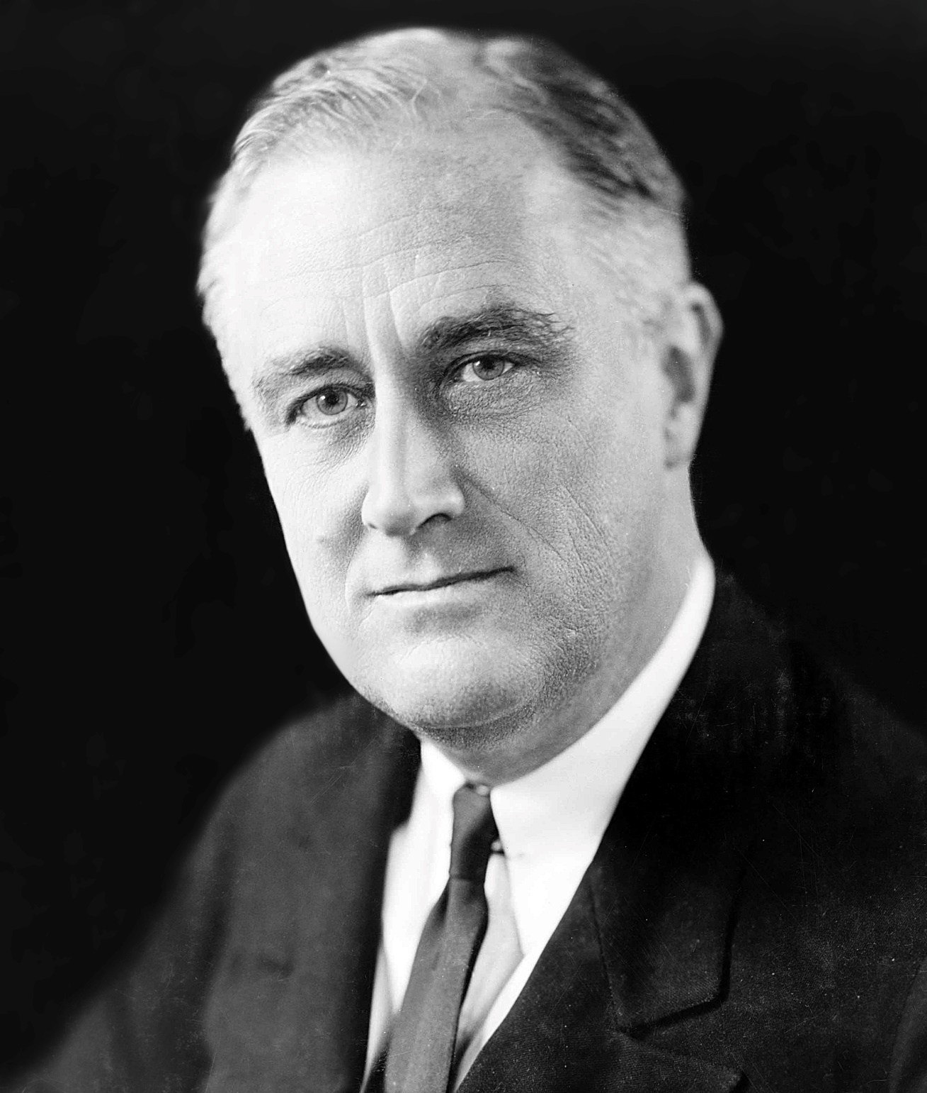
32nd President
Franklin D. Roosevelt in 1933
© Brain Wrinkles

Slide 53
New Deal
The New Deal was Roosevelt’s plan to use government programs to help the nation recover from the Depression.
The New Deal had 3 goals:
reduce unemployment by creating jobs
provide relief for the needy in order to jump start the economy
change businesses practices so economic crisis couldn’t happen again
© Brain Wrinkles

Slide 54
New Deal
Roosevelt first sent federal money to state governments to help struggling citizens.
Next, Roosevelt, along with his advisors, developed a series of programs that would help pull America out of the Great Depression.
Examples include the Civilian Conservation Corps (CCC), Agricultural Adjustment Act (AAA), Rural Electrification Administration (REA), and the Social Security Administration (SSA).
© Brain Wrinkles

Slide 55
CCC
The Civilian Conservation Corps (CCC) gave jobs to men between the ages of 18 to 25.
Workers signed up for a project and lived together in camps until the project’s completion.
The CCC put young men to work preserving America’s natural resources.
© Brain Wrinkles

Slide 56
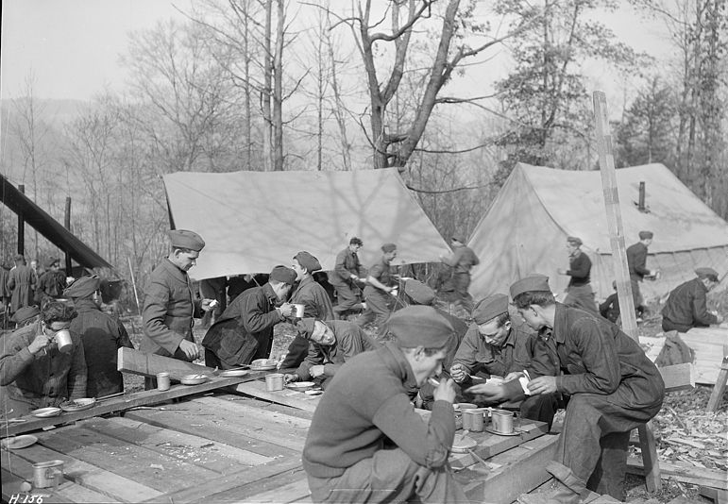
Lunch Time at a CCC Camp
© Brain Wrinkles

Slide 57
CCC
The CCC built roads, planted forests, and worked on irrigation and national park projects.
Projects in Georgia included planting trees in the Chattahoochee National Forest and working on the Appalachian Trail.
By 1941, more than 3 million young men had worked for the CCC.
© Brain Wrinkles

Slide 58
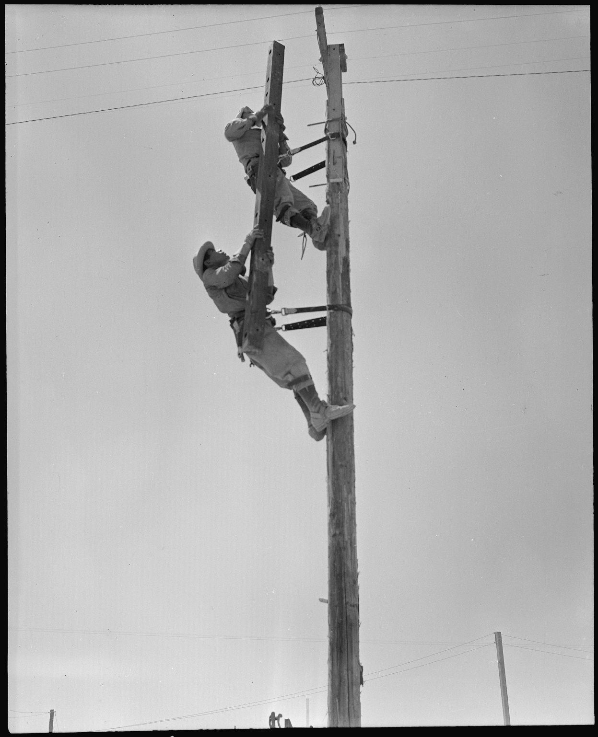
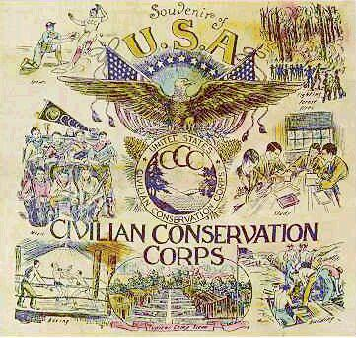
CCC Workers Building Telephone Poles
© Brain Wrinkles

Slide 59
AAA
Overproduction of farms was the main reason farmers could not get out of debt.
The Agricultural Adjustment Act was passed in 1933, and actually paid farmers a subsidy NOT to produce certain crops in order to raise farm prices.
It also encouraged Georgia’s farmers to stop relying solely on cotton, and to plant peanuts, corn, tobacco, and other crops.
© Brain Wrinkles

Slide 60
AAA
The act was successful in Georgia because it restricted the supply of products and drove the prices up so farmers could make a profit.
By 1950, Georgia was the country’s leader in peanut production and poultry (chicken farms).
The state’s peach farming industry also made a huge comeback after years of decline.
© Brain Wrinkles

Slide 61
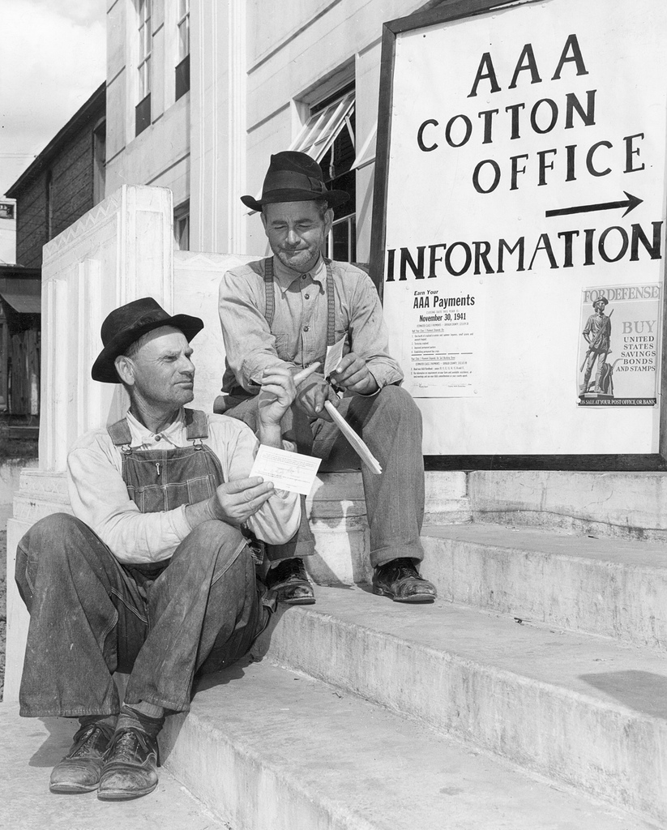
© Brain Wrinkles

Slide 62
REA
Roosevelt also set up the Rural Electrification Administration in 1935.
At this time, 97% of Georgia’s farms were without electricity.
The REA offered low-interest loans to companies to build power lines in rural areas.
Within 15 years, most of Georgia’s farms had power.
© Brain Wrinkles

Slide 63
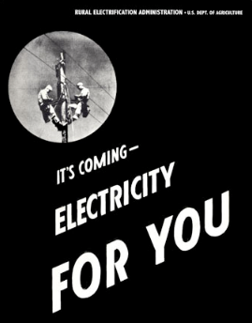
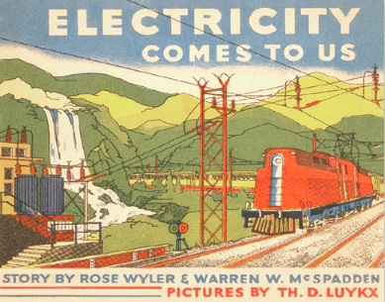
© Brain Wrinkles

Slide 64
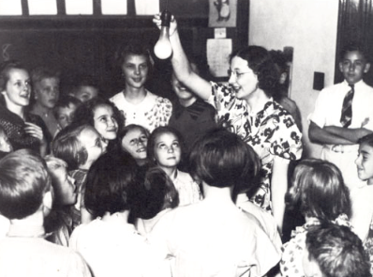
Rural Schools Receives Electricity
© Brain Wrinkles

Slide 65
SSA
President Roosevelt also introduced Social Security as part of the New Deal, and Congress passed the Social Security Act in 1935.
The law provided retirement pay and other government benefits for workers.
It also provided insurance for disabled, unemployed, and elderly people through contributions made by employees and their employers.
© Brain Wrinkles

Slide 66
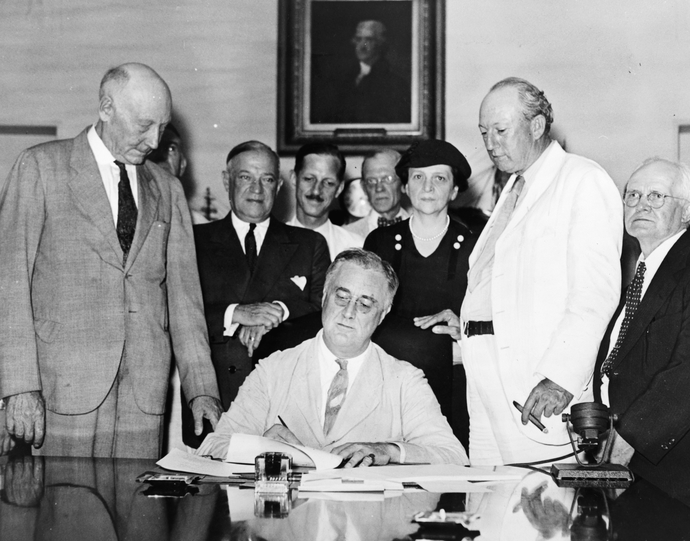
President Roosevelt Signing Social Securities Act - 1935
© Brain Wrinkles

Slide 67
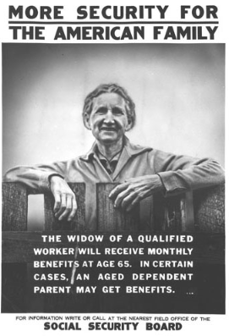
Social Security is the only New Deal program still around today.
© Brain Wrinkles

Slide 68
The End?
While the New Deal did not completely restore the country to the way it was before the Depression, it did help many poor Americans cope during difficult economic times.
It wasn’t until 1942 that the Depression was truly over – when America entered World War II…
© Brain Wrinkles

Slide 69
EUGENE
TALMADGE
SS8H8c
© Brain Wrinkles

Slide 70
Talmadge
Eugene Talmadge, a powerful Georgia politician, opposed many of the New Deal programs.
Talmadge served as Georgia’s governor from 1933-1937 and from 1941-1943.
He had a compelling, yet controversial, personality that many Georgians loved, but others could not stand.
© Brain Wrinkles

Slide 71
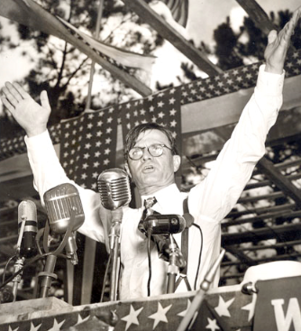
© Brain Wrinkles

Slide 72
Support
Many Georgians backed Talmadge because he appealed to the rural population that had been struggling for decades.
Talmadge fought for the interests of Georgia’s poor farmers, and in return, they supported him passionately.
© Brain Wrinkles

Slide 73
Racism
Talmadge opposed civil rights for African Americans.
He fought for segregation of Georgia’s schools and fired teachers who supported integration.
Talmadge was referred to as a dictator by many Georgians because of his reputation of firing anyone who opposed him.
© Brain Wrinkles

Slide 74
No Deal
Talmadge believed that the federal government should stay out of state matters and he refused to back most of Roosevelt’s policies.
He also argued that the New Deal programs helped both blacks and white equally, something he was strongly against.
Governor Talmadge did everything he could to keep New Deal programs away from Georgia.
© Brain Wrinkles

Slide 75
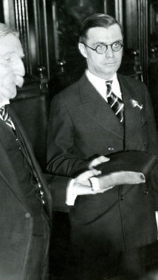
Talmadge being sworn in as Georgia’s Governor – 1933.
© Brain Wrinkles

Slide 76
Goodbye
Because of his opposition, much of the aid offered by New Deal programs did not affect Georgia until after Talmadge left office.
The desire for Social Security in Georgia led to the election of pro-New Deal governor Eurith Rivers, who brought more helpful programs into the state.
© Brain Wrinkles

Slide 77
Georgia &
PRESIDENT
ROOSEVELT
SS8H8d
© Brain Wrinkles

Slide 78
Polio
Franklin Roosevelt visited Georgia over 40 times from 1913-1945.
Roosevelt had a disease called polio, and visited Warm Springs for polio therapy.
Roosevelt, and other polio patients, exercised in the warm water pools of the spring to help ease the crippling effects of polio.
© Brain Wrinkles

Slide 79
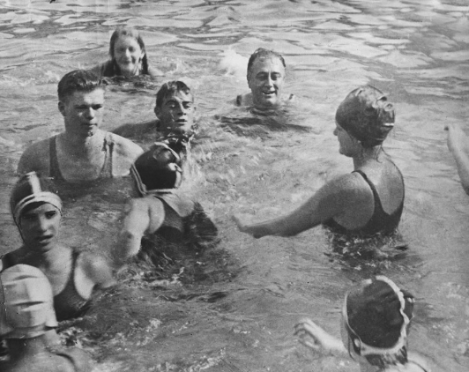
President Roosevelt in a Warm Springs Pool
© Brain Wrinkles

Slide 80
Warm Springs
In 1927, Roosevelt established the Warm Springs Foundation and built a home there.
He stayed here when he visited Georgia, and it became known as the “Little White House” during his presidency.
© Brain Wrinkles

Slide 81
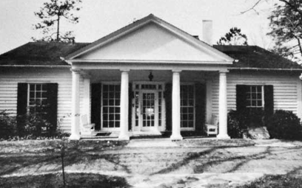
The Little White House
© Brain Wrinkles

Slide 82
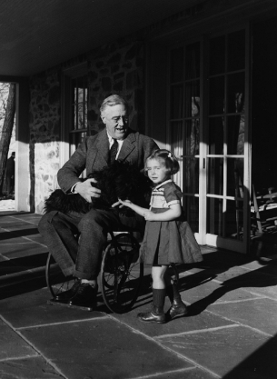
© Brain Wrinkles

Slide 83
Support
Many Georgians were big supporters of Roosevelt, and he gave many speeches throughout the state.
His firsthand exposure to rural Georgia during the Depression helped him create effective New Deal programs that helped alleviate economic problems throughout the country.
© Brain Wrinkles

Slide 84
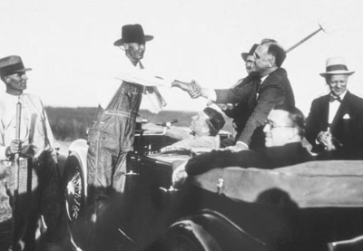
President Roosevelt Visits Georgia Farmers
© Brain Wrinkles

Slide 85
Help
Roosevelt’s New Deal policies assisted many Georgians.
His agricultural policies helped Georgia’s farmers and the work programs gave jobs to Georgia’s unemployed.
© Brain Wrinkles

Slide 86
Legacy
President Roosevelt was visiting Warm Springs on April 12, 1945, when he died after suffering a massive stroke.
Today, many people still go to Warm Springs for treatment of strokes and injuries at the Warm Springs Rehabilitation Center, and Roosevelt’s home is visited by thousands every year.
© Brain Wrinkles

Slide 87
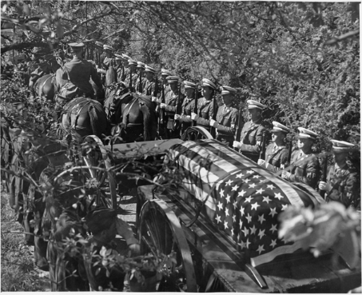
© Brain Wrinkles

